Slide 1


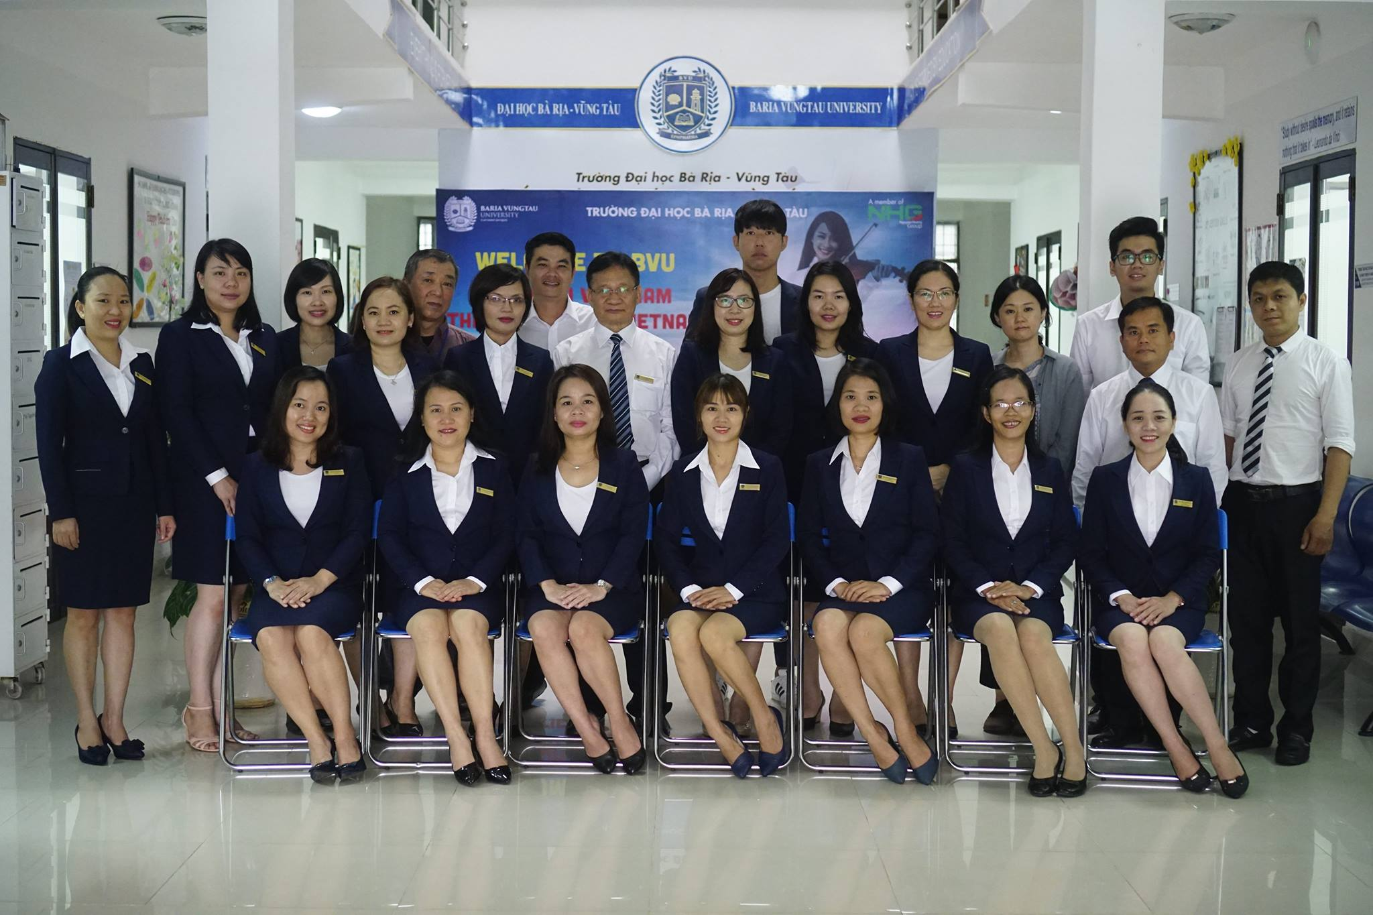

Slide 2
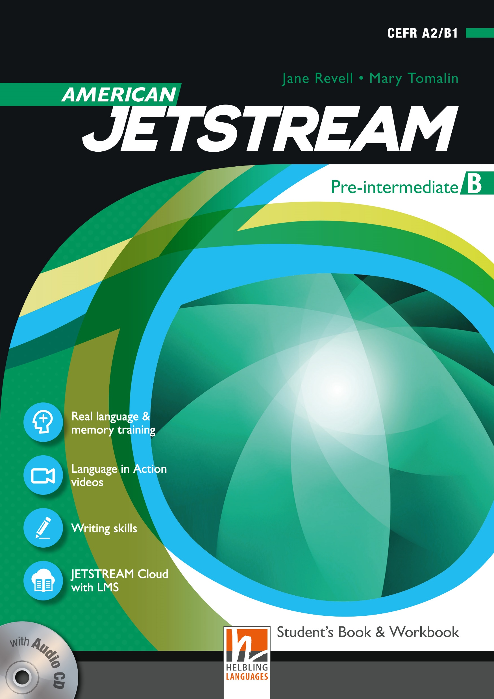
AMERICAN JETSTREAM PRE-INTERMEDIATE B

Slide 3
TEACHER’S PERSONAL INFORMATION
Name: Nguyen Thanh Loan
Facebook: Loan Nguyễn Thanh
Mobile number: 0942 255 937
Email: loannguyenthanh1978@gmail.com

Slide 4
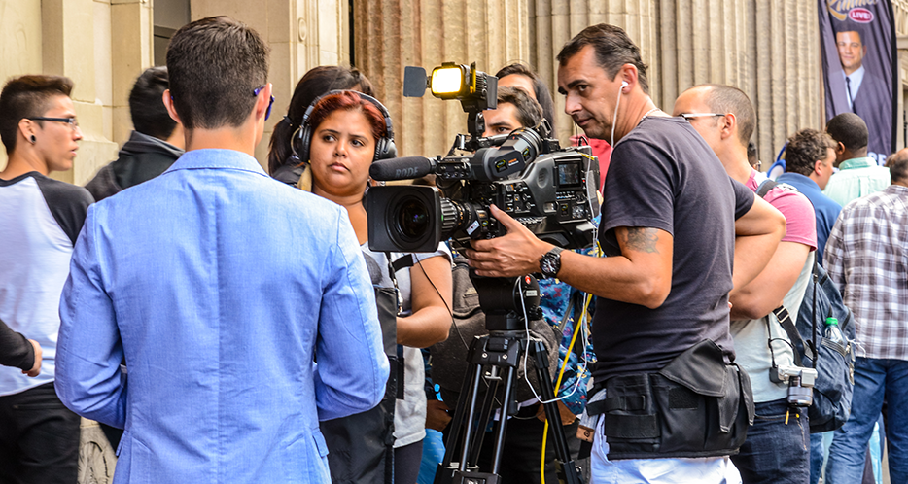
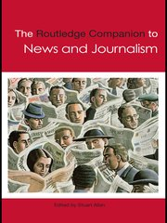
UNIT 9 & 10
REVIEW (unit 9 + 10)

Slide 5
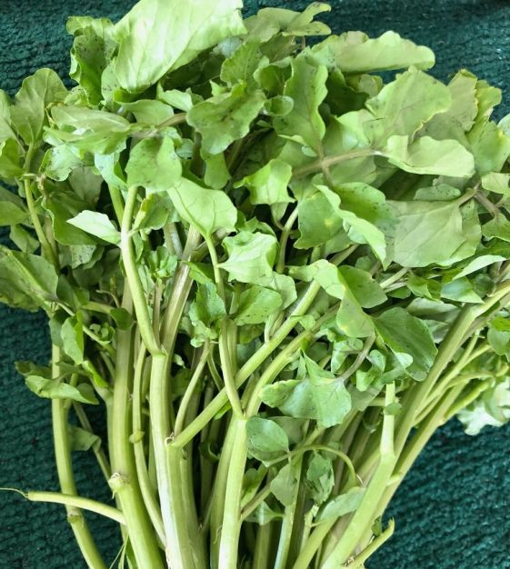
VOCABULARY
SUPERFOODS
watercress
/ˈwɔːtəkres/
a water plant with small round green leaves and thin stems. It has a strong taste and is often eaten raw in salads.

Slide 6
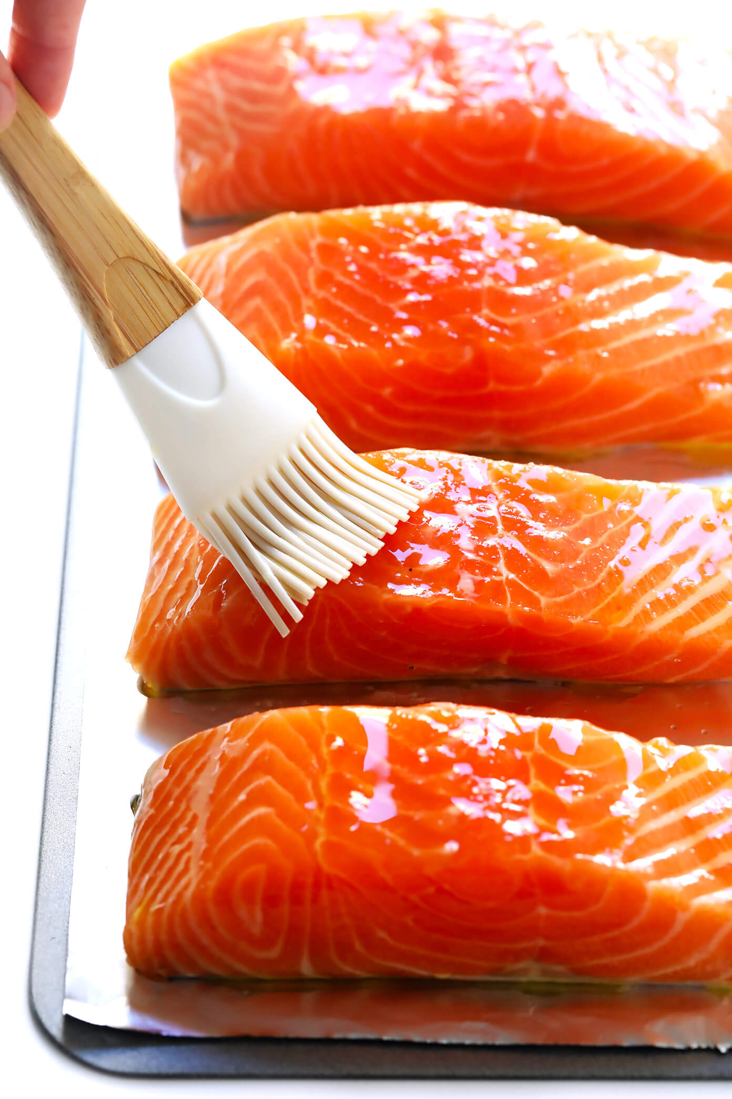
VOCABULARY
SUPERFOODS
salmon
/ˈsæmən/
a large fish that has silver skin and is pink inside and is used for food. Salmon live in the sea but swim up rivers to lay their eggs.

Slide 7
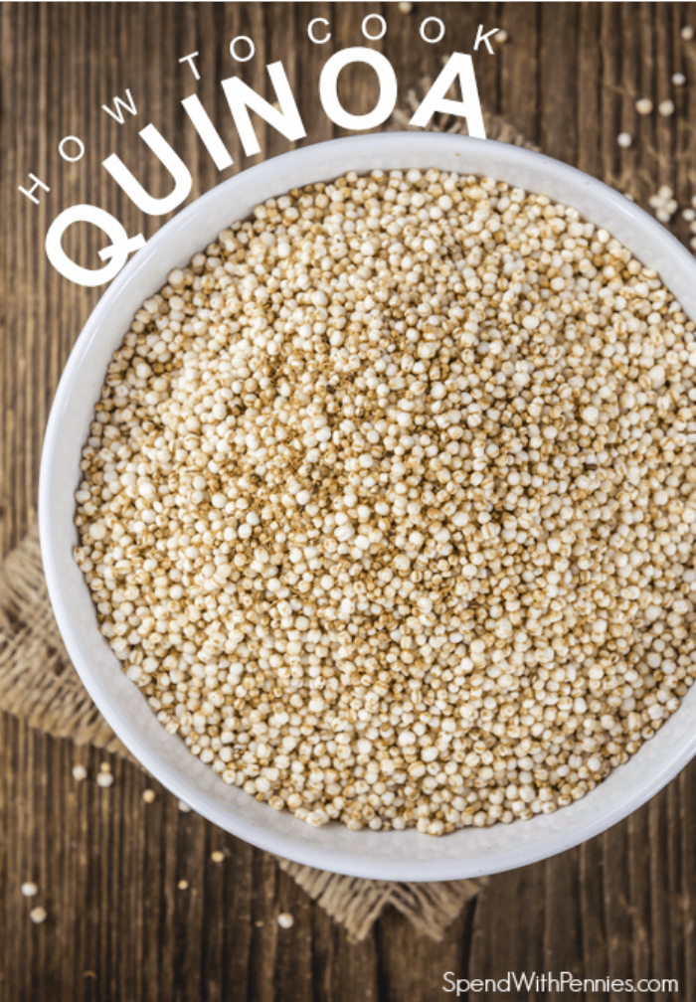
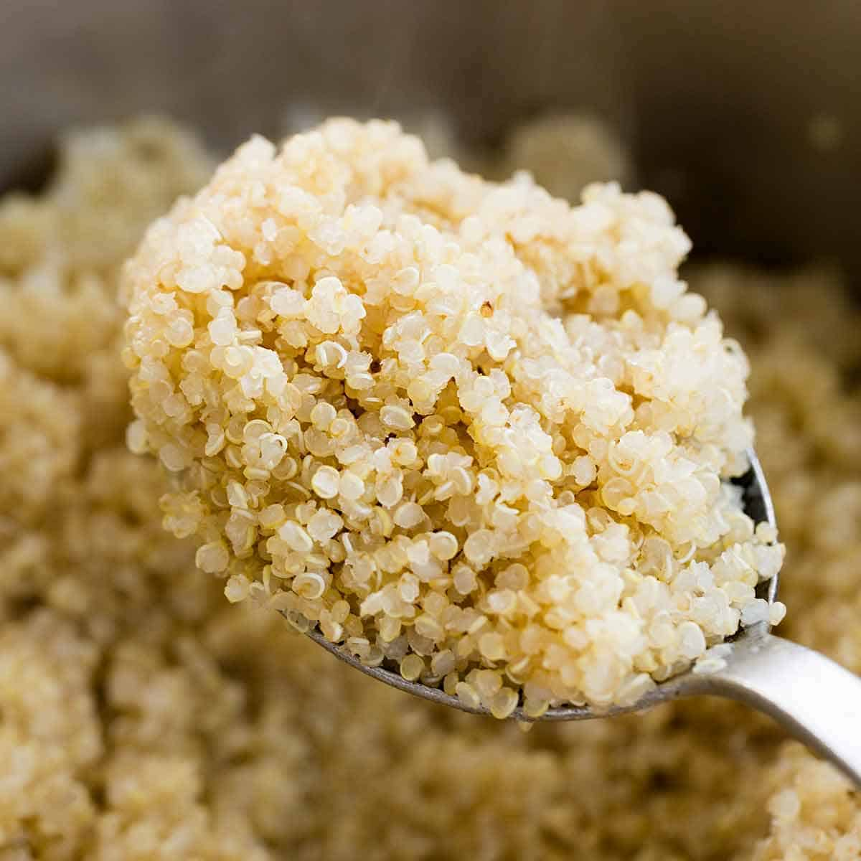
VOCABULARY
SUPERFOODS
quinoa
/ˈkiːnwɑː/
Hạt quinoa (hạt diêm mạch)
a South American plant, grown for its seeds, used as food and to make alcoholic drinks; the seeds of the quinoa plant

Slide 8
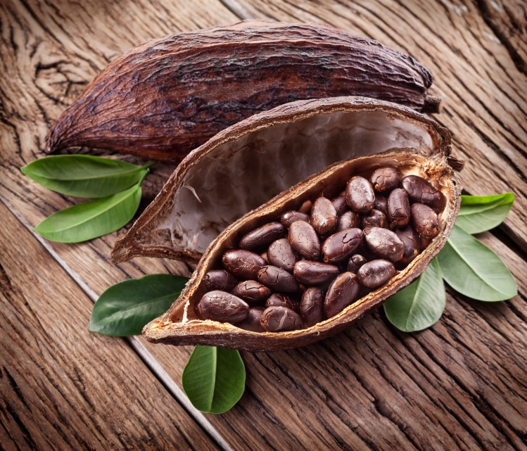
VOCABULARY
SUPERFOODS
cocoa
/ˈkəʊkəʊ/
dark brown powder made from the seeds (called cocoa beans) of a tropical tree

Slide 9
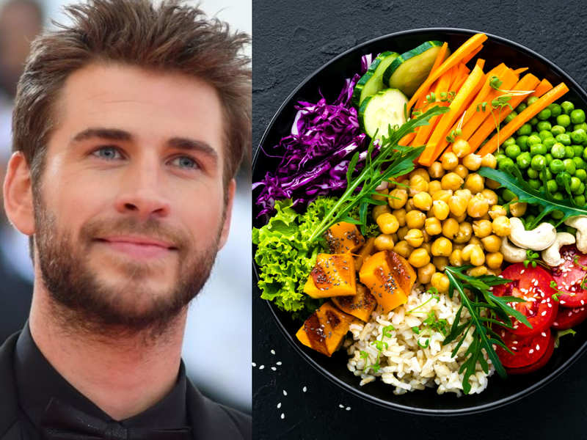
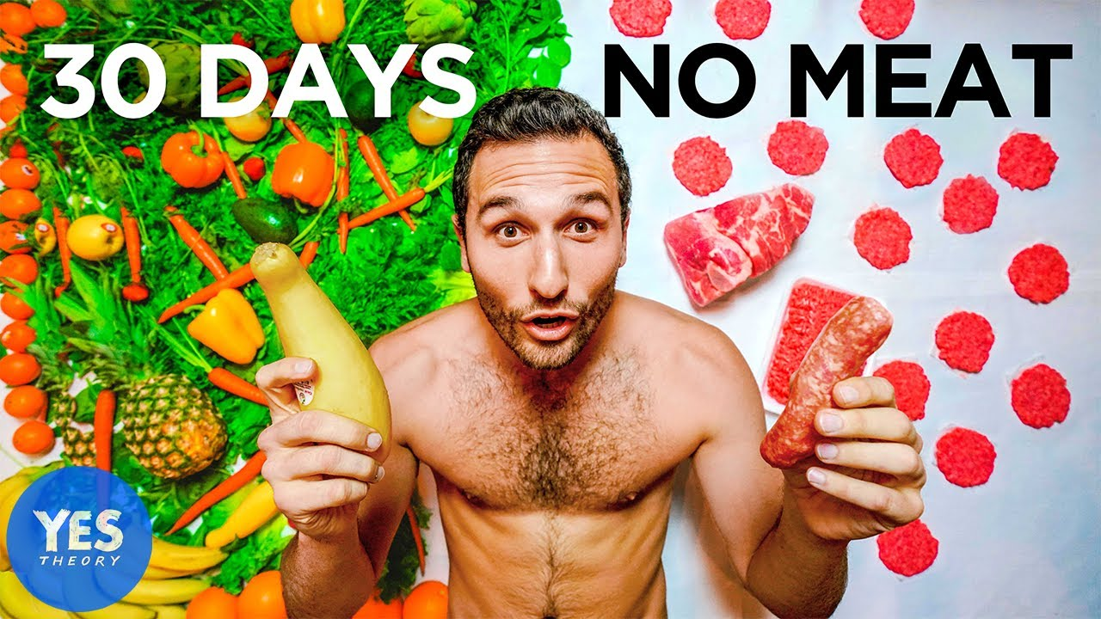
VOCABULARY
SUPERFOODS
vegan
/ˈviːɡən/
a person who does not eat any animal products such as meat, milk or eggs or use animal products such as leather or wool

Slide 10
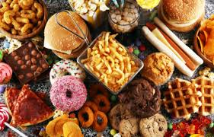
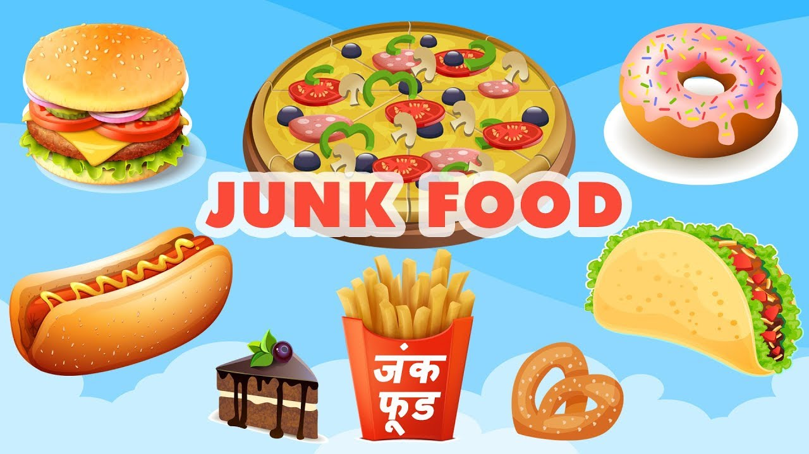
VOCABULARY
SUPERFOODS
Junk food
/ˈdʒʌŋk fuːd/
​food that is quick and easy to prepare and eat but that is thought to be bad for your health

Slide 11
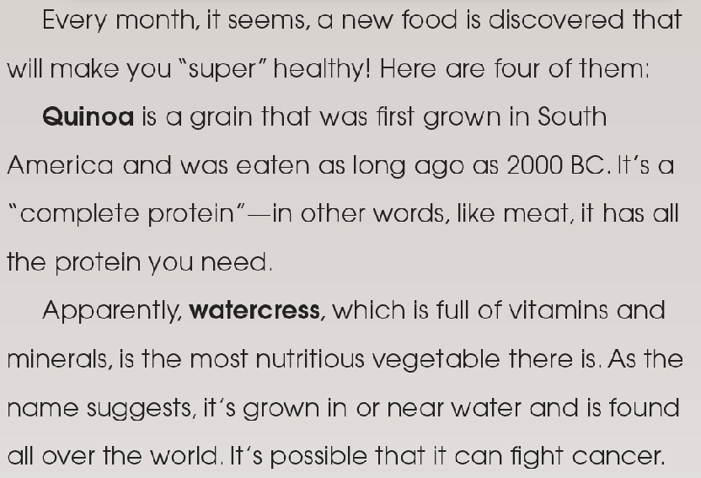
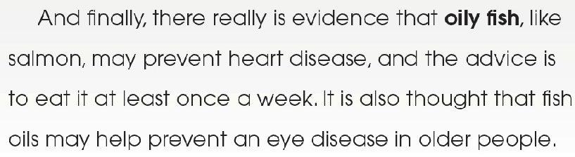
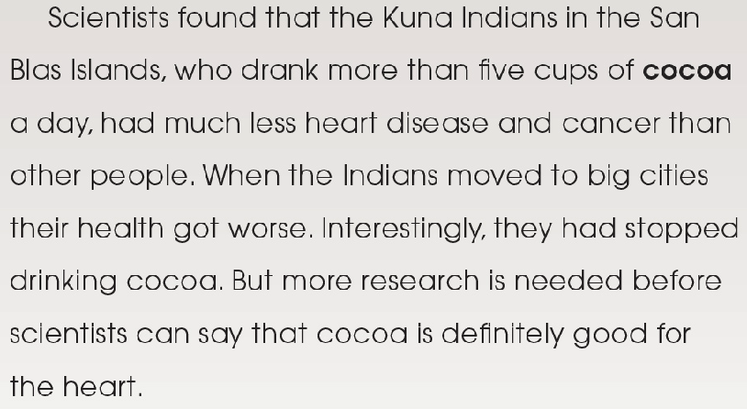
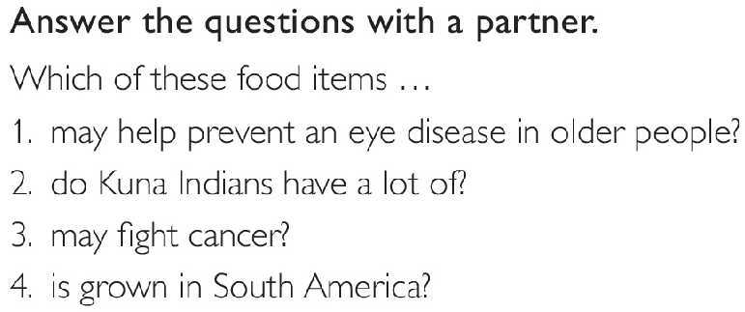
Reading
Superfoods

Slide 12
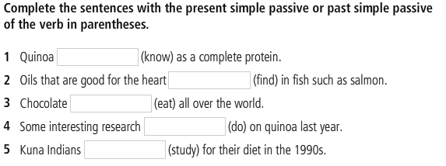
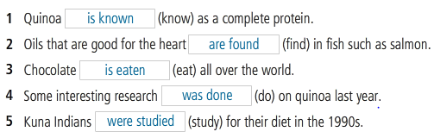
Reading and Grammar

Slide 13
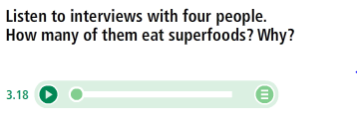

Listening and Grammar

Slide 14
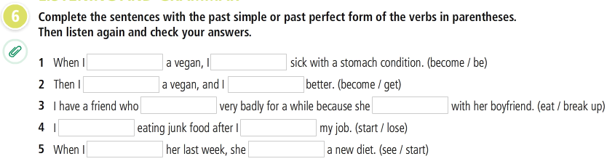
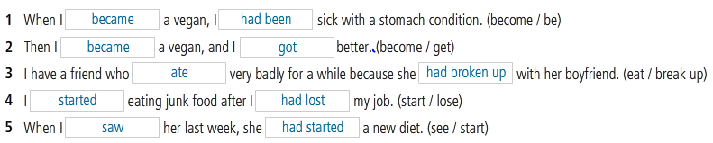
LISTENING
Listen to interviews with four people. How many of them eat superfoods? Why?

Slide 15
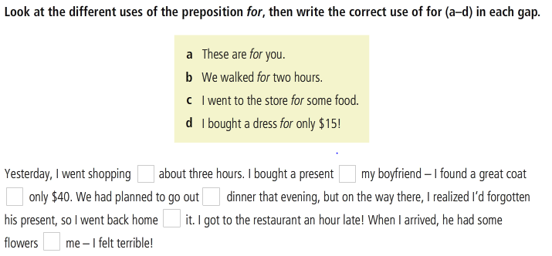
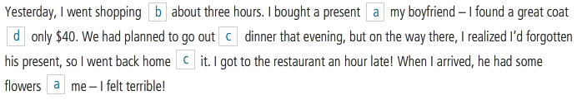
Preposition park

Slide 16
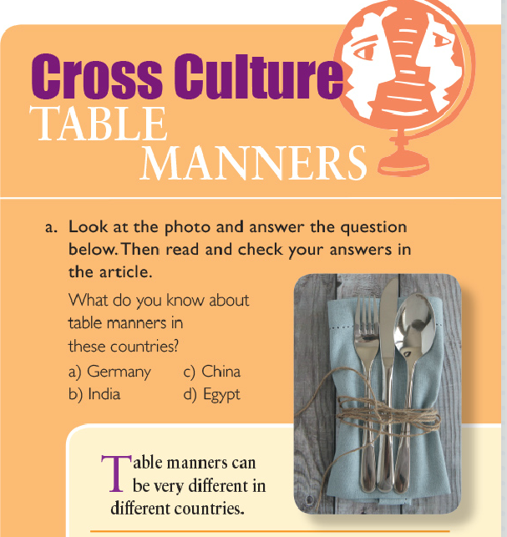
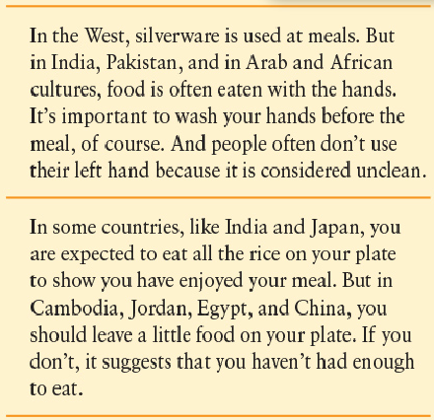

Slide 17

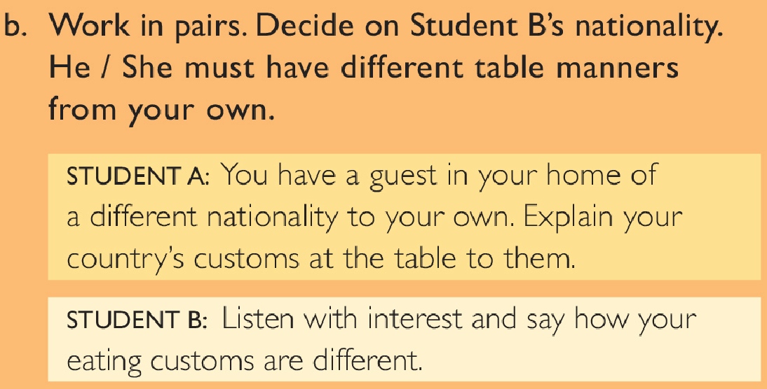
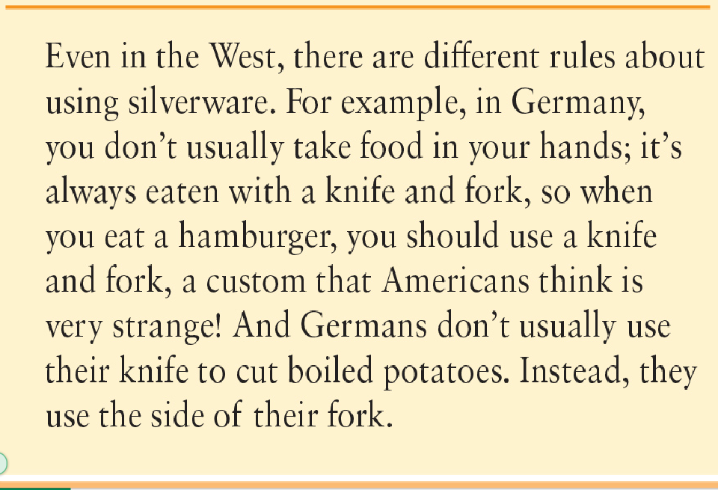

Slide 18
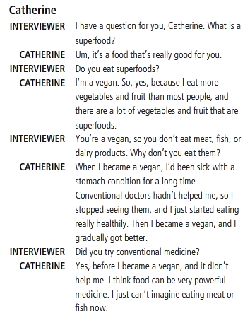
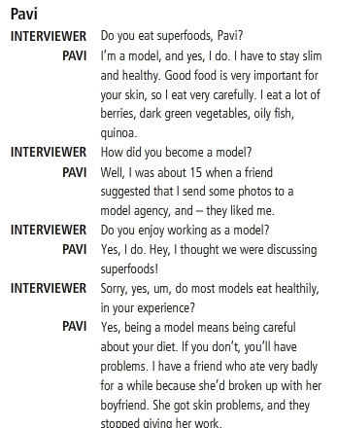
Audioscript

Slide 19
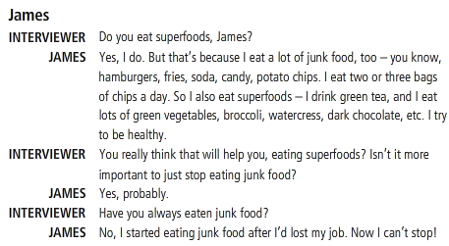
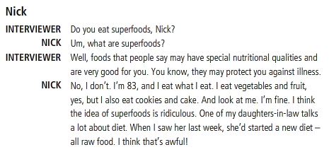
Audioscript

Slide 20
REFERENCES
Vocabulary: Superfoods
https://www.youtube.com/watch?v=ymfrsjzGKMA
Cross culture: Table manners - Dining customs around the world
https://www.youtube.com/watch?v=OIdYxMyZZm4

